Slide 1
Design of Home Automation System Using IoT Technology
Ndubuisi Iwuala
Kingsley Asonye

Slide 2
Outline
Introduction
Objective
Design Requirements
Design Constraints
Design Method
System Diagram
Implementation Plan
Team Organization/Responsibilities
Project Timeline and Delivery Plan
Implementation of Tasks
Future Plans
ABET Outcomes

Slide 3
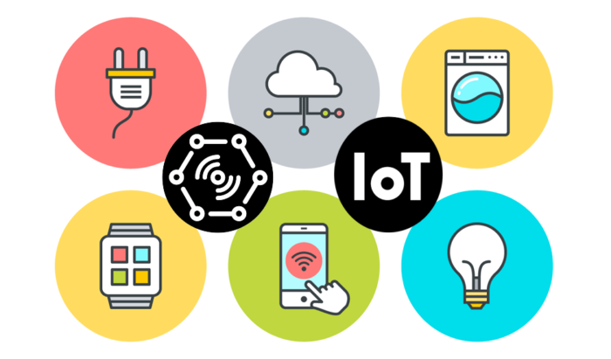
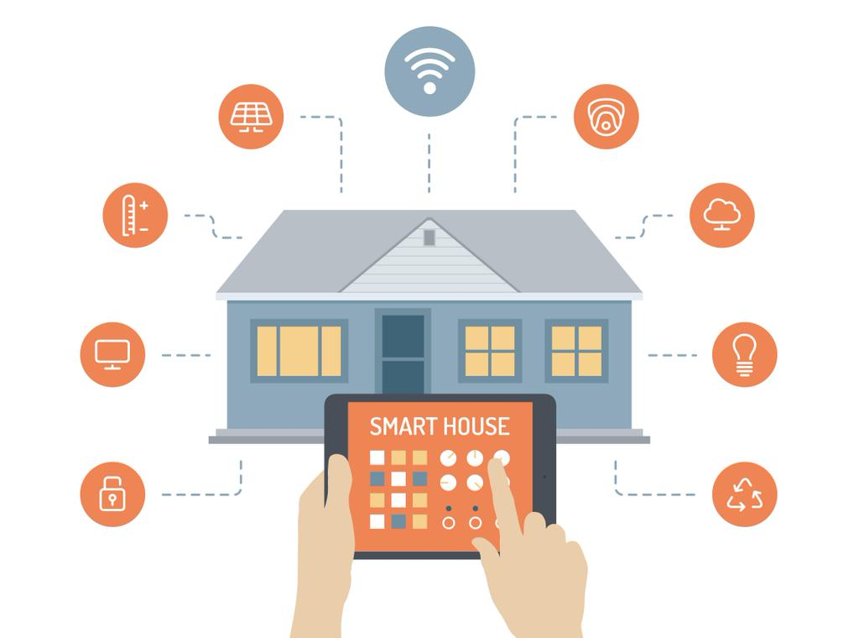
Introduction
Home automation is valuable in our lives to base on the fact that it makes tasks more convienient & can save you money on utilities. IoT technology also creates a connection between various devices to send and receive data efficently.

Slide 4
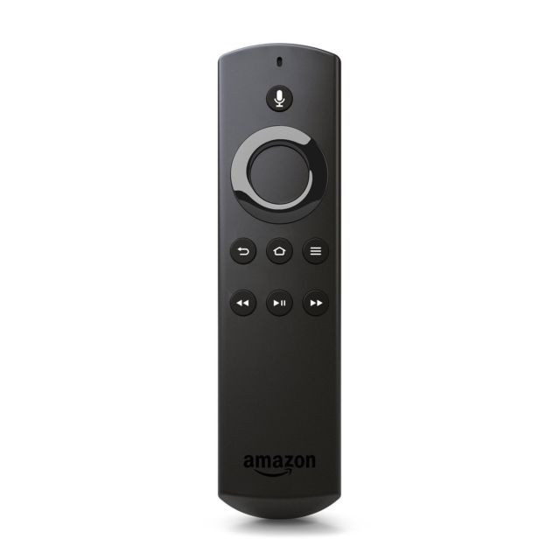
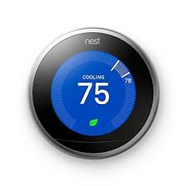
Examples of IoT devices on the market
SMART REMOTE
Nest thermostat

Slide 5
Objective
The objective of this project is to design a voice-controlled system using IoT technology that will allow a user to control appliances with spoken commands & an open/close system that will notify users if the door, window, etc. is open

Slide 6
Design Requirements
Lights (Lamp) will be controlled by voice
Temperature functions will be controlled by voice
Television functions will be controlled by voice
User will be notified with front door is opened
Current & target temperature as well as unit setting will be displayed
Will use AVS (Alexa Voice Services) for voice control capability.

Slide 7
Design Constraints
Internet connectivity is required due to the use of IoT devices
$100 Budget

Slide 8
Design Method
AVS Prototype on Raspberry Pi
Remote Control Design
Alexa Skill Program
Data Channel for Television, Temperature, and Lights
Temperature Control Design
AWS Lambda Program
Open/Close Sensing Design
Light Control Design
Power Calculation
Encasing Design
Design Verification

Slide 9
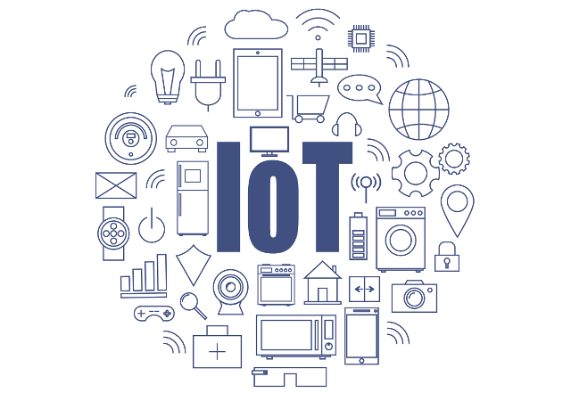
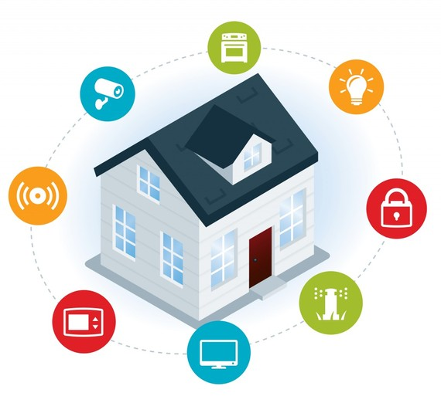
System Description
This home automation system is controlled by the Raspberry Pi. The Pi takes the role of an Amazon Echo, which receives a spoken command and then executes the command given. Design control will be created for each appliance along with programming the NodeMCU, an IoT device. This will ensure the command is executed by the appliance.

Slide 10
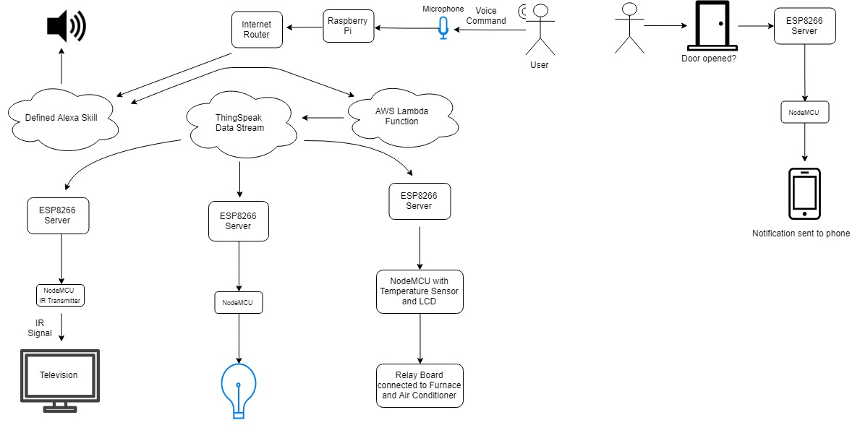
System Diagram

Slide 11
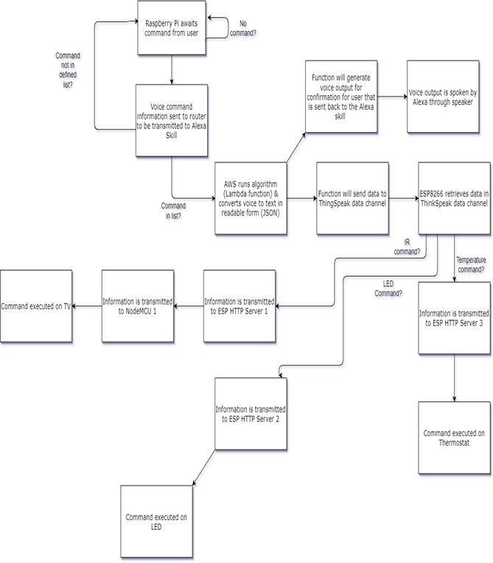
System Function

Slide 12
Implementation Plan
Task 1. Create AVS Prototype on Raspberry Pi
Task 2. Alexa Skill Program
Task 3. Data Channel setup for the television, temperature, and lights.
Task 4. AWS Lambda Function
Task 5. Remote Control Design
Task 6. Temperature Control Design
Task 7. Stand-Alone Light Control Design
Task 8. Open/Close Detection Design
Task 9. Power Calculation
Task 10. Design Verification
Legend:
Completed
In progress
Next semester

Slide 13
Team Organization/Responsibilities
Responsibilities of Team Member 1: Ndubuisi Iwuala
Task 1. Create AVS Prototype on Raspberry Pi
Task 2. Alexa Skill Program
Task 3. Data Channel setup for the television, temperature, and lights.
Task 4. AWS Lambda Function
Task 5. Remote Control Design
Task 6. Temperature Control Design
Task 7. Stand-Alone Light Control Design
Task 8. Open/Close Detection Design
Task 9. Power Calculation
Task 10. Design Verification

Slide 14
Team Organization/Responsibilities (cont.)
Responsibility of Team Member 2: Kingsley Asonye
Task 5. Remote Control Design
Task 6. Temperature Control Design
Task 7. Stand-Alone Light Control Design
Task 8. Open/Close Detection Design
Task 9. Power Calculation
Task 10. Design Verification

Slide 15
Project Timeline & Delivery Plan
Time | Task | Comments | Responsible Personnel
Week 10 | Begin Task 1 | Create AVS Prototype on Raspberry Pi | Ndubuisi
Week 11 | Begin Subtask 2.1, 2.2, 2.3 | Alexa Skill Program | Ndubuisi
Week 12 | Finish Task 2 & Begin Task 3 | Data Channel Setup | Ndubuisi
Week 13 | Finish Task 3 & Being Subtask 4.1, 4.2, 4.3 & Begin Subtask 5.1, 5.2, 5.3 | 3 weeks needed to complete AWS Lambda Function for Light, Thermostat, and Television Control. 2 weeks needed to complete Subtask 5.1, 5.2 5.3. Task 5 will carry over to next semester. | Ndubuisi/Kingsley
Week 14 | Finish Subtask 5.1, 5.2, 5.3 & Begin Subtask 6.1 & 6.2 | 3 weeks needed to complete Subtask 6.1 & 6.2. Task 6 will carry over to next semester. | Kingsley
Week 15 | Finish Subtask 4.1, 4.2, 4.3 & Begin Subtask 7.1, 7.2 | 2 weeks needed to complete Subtask 7.1, 7.2. Task 7 will carry over to next semester | Ndubuisi/Kingsley
Week 16 | Begin Task 8 | 4 weeks needed to complete all Subtasks for Task 8. | Ndubuisi/Kingsley
Week 17 | Begin Subtask 5.4, 5.5, 5.6 | 3 weeks needed to complete Subtask 5.4, 5.5, 5.6 | Ndubuisi/Kingsley
Week 18 | Begin Subtask 6.3, 6.4, 6.5 & Subtask 7.3, 7.4, 7.5 | 3 weeks needed to complete Subtask 6.3, 6.4, 6.3 & Subtask 7.3, 7.4, 7.5 | Ndubuisi/Kingsley
Week 19 | Finish Subtask 5.4, 5.5, 5.6 & Task 8 | Finish & Finalize remote and open/close designs | Ndubuisi/Kingsley
Week 20 | Finish Subtask 6.3, 6.4, 6.5 &7.3, 7.4, 7.5 & Begin Task 9 | Finish & Finalize Temperature | Ndubuisi/Kingsley
Week 21 | Finish Task 9 | Complete Power Calculation for each Device | Ndubuisi/Kingsley
Week 22 | Begin Task 10 | Begin Design Verification | Ndubuisi/Kingsley

Slide 16
Implementation of Tasks

Slide 17
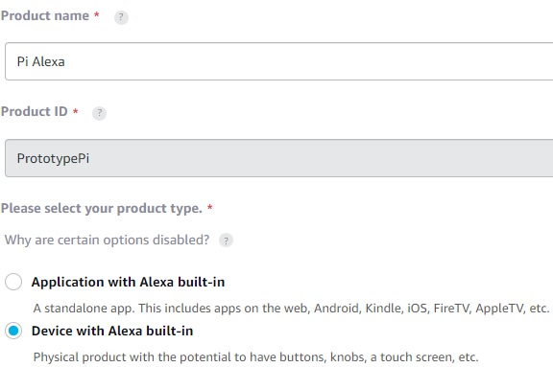
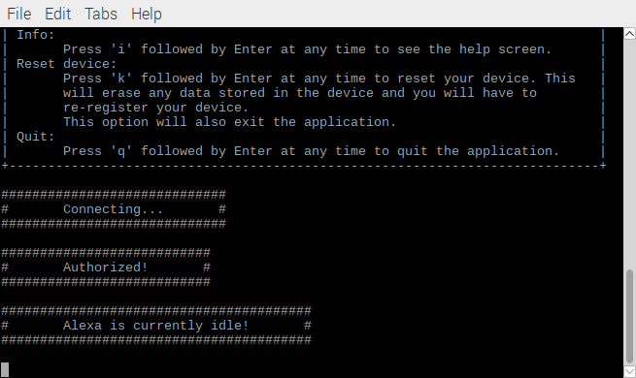
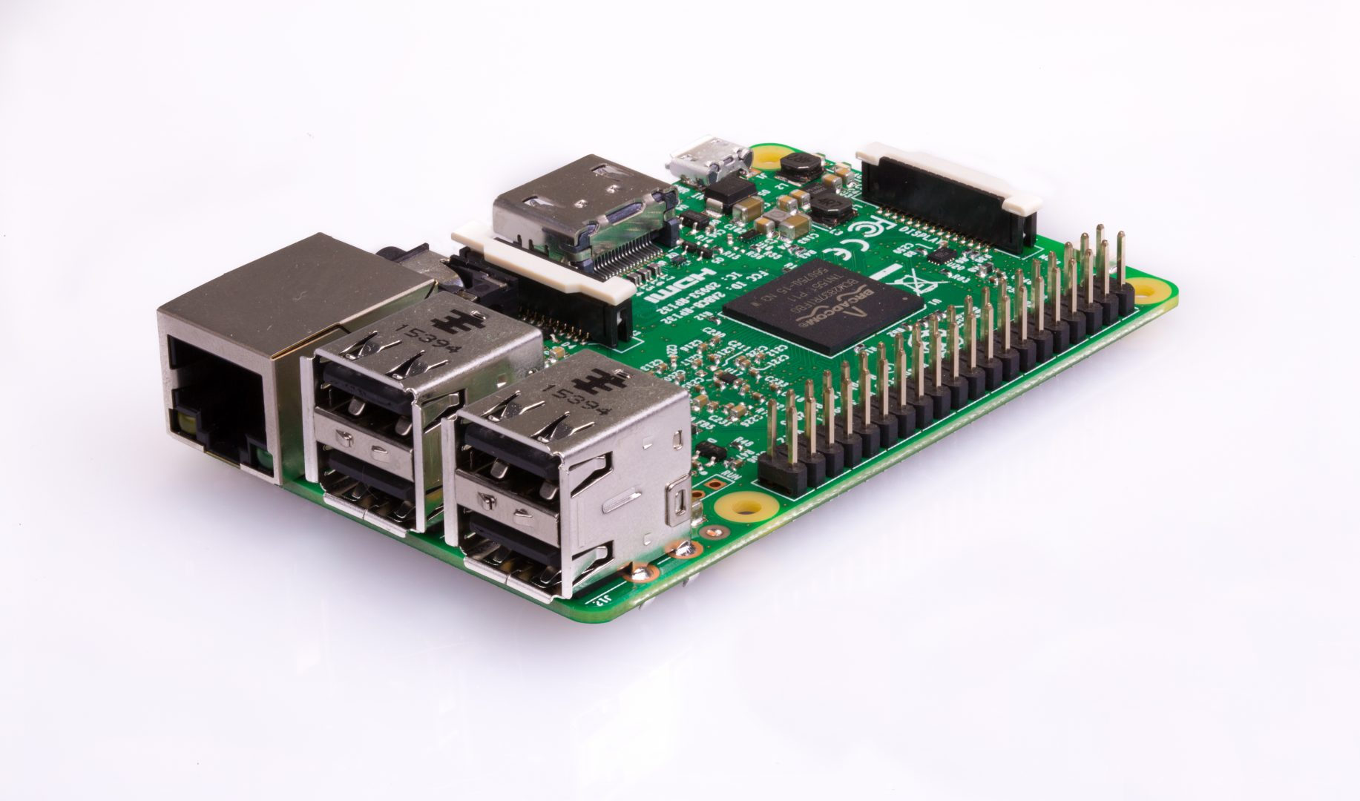
Implementation of Task 1
Registered Raspberry Pi with Alexa Voice Services
Used product and security IDs to authorize pi for Alexa use
Create AVS Prototype on Raspberry Pi

Slide 18
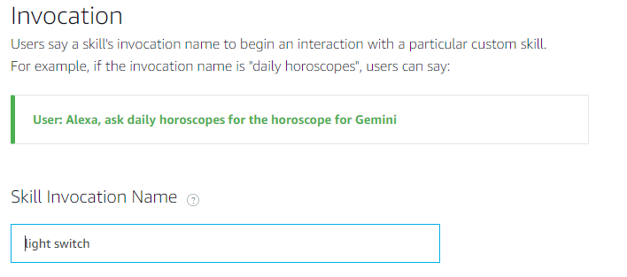
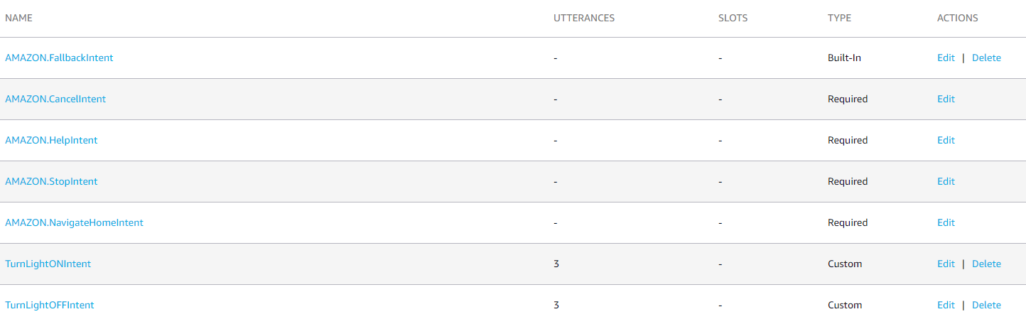
Implementation of Task 2
Created custom intents for each skill.
Mapped sample utterances for each skill
Program Alexa Skill for light control
Program Alexa Skill for television remote control function
Program Alexa Skill for thermostat control function

Slide 19
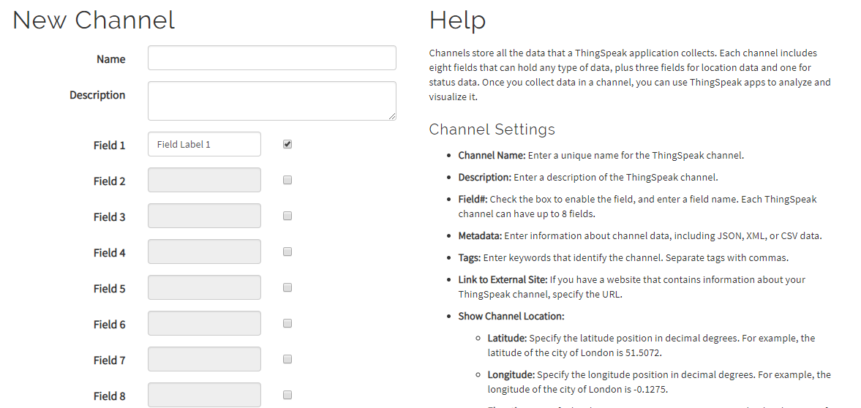
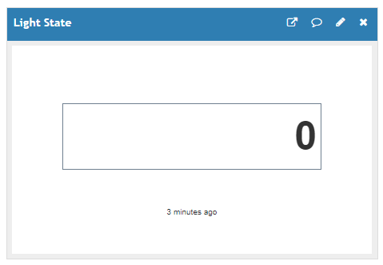
Implementation of Task 3
Create a data channel for the television, temperature, and lights

Slide 20
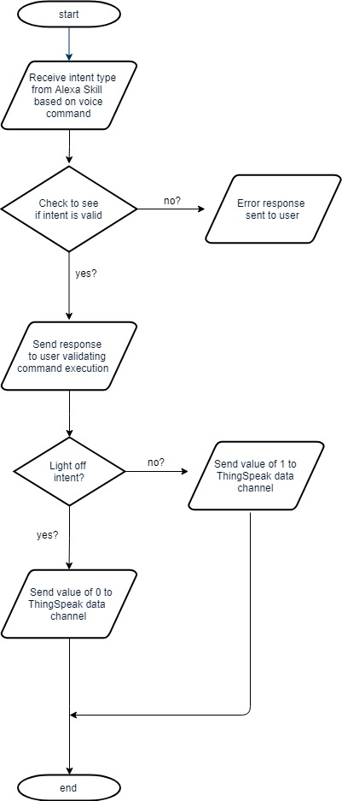
Implementation of Task 4.1
Light Control Flowchart
Program Lambda functions for light control

Slide 21
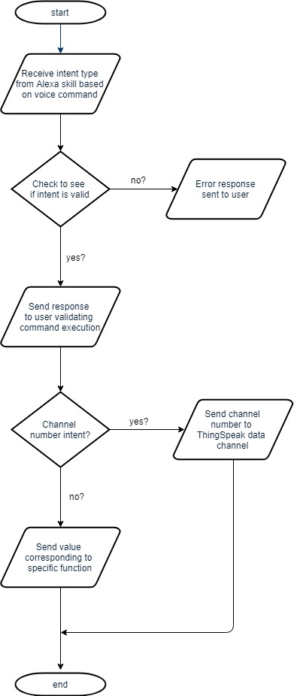
Implementation of Task 4.2
Television Control Flowchart
Program Lambda function for television control

Slide 22
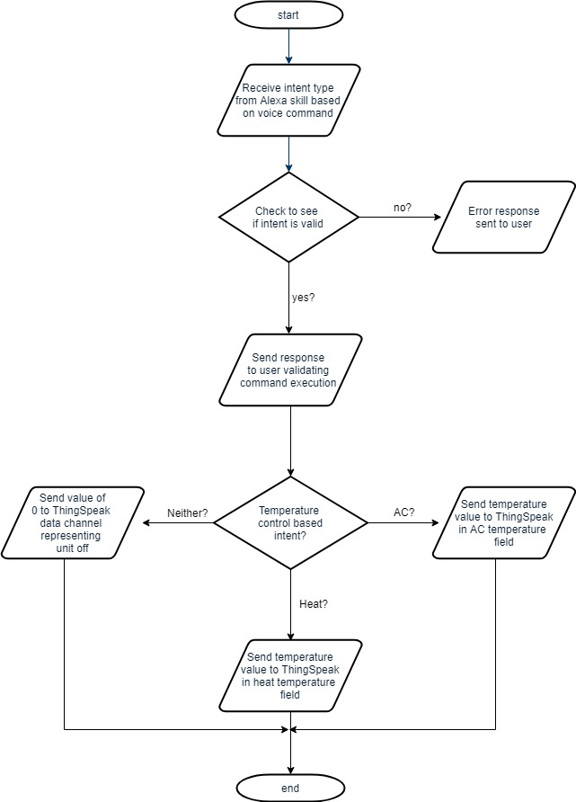
Implementation of Task 4.3
Temperature Control Flowchart
Program Lambda function for temperature control

Slide 23
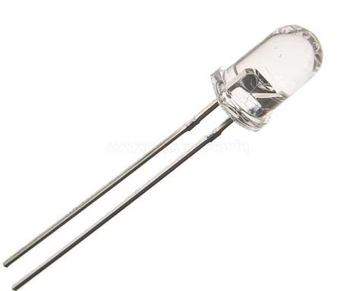
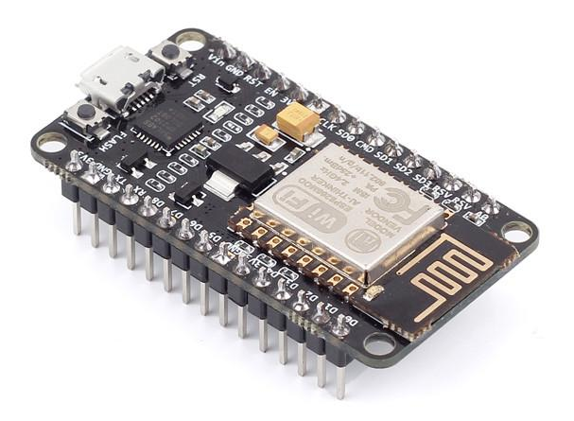
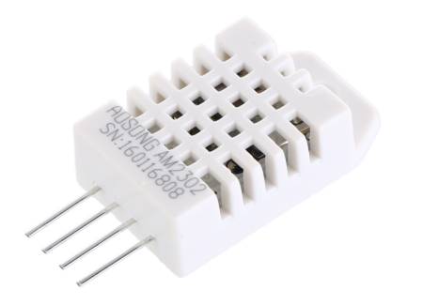
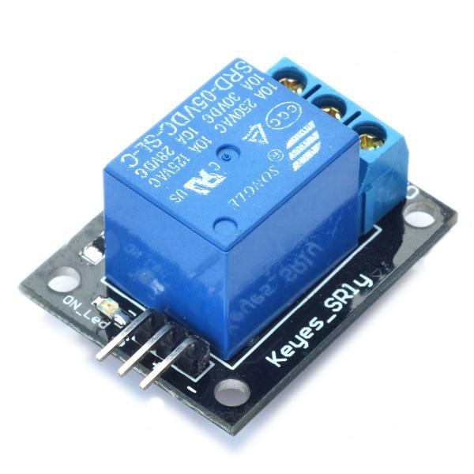
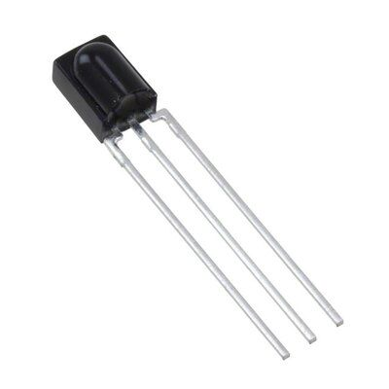
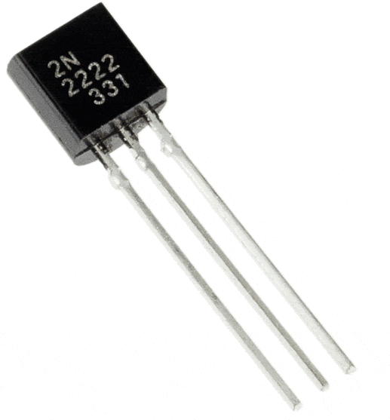
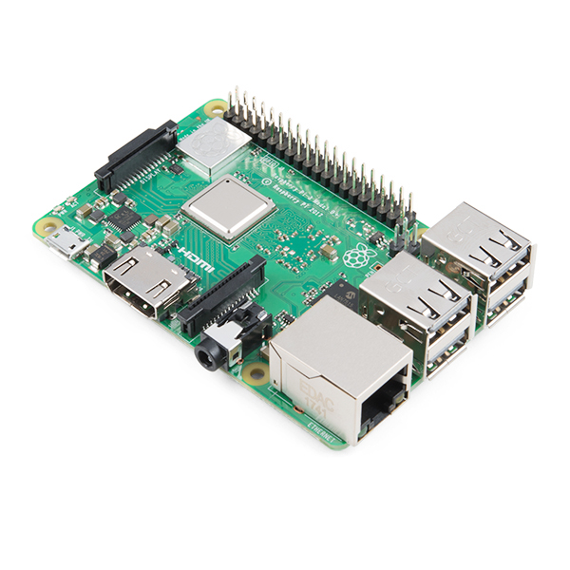
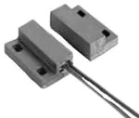
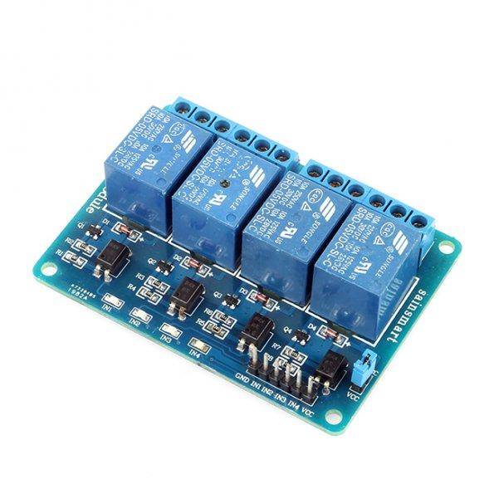

Slide 24
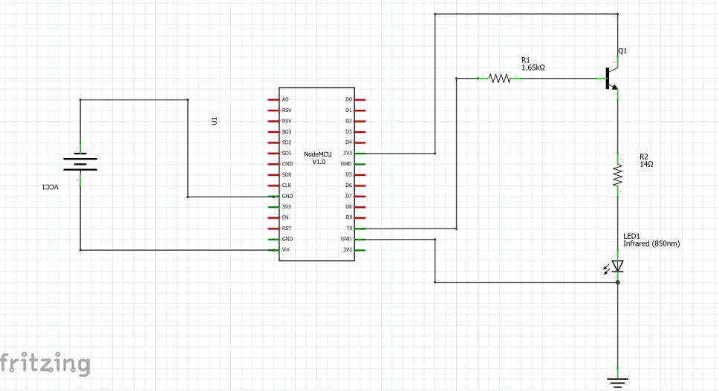
Implementation of Task 5.1
Schematic of IR transmitter circuit
Create schematic for IR transmitter

Slide 25
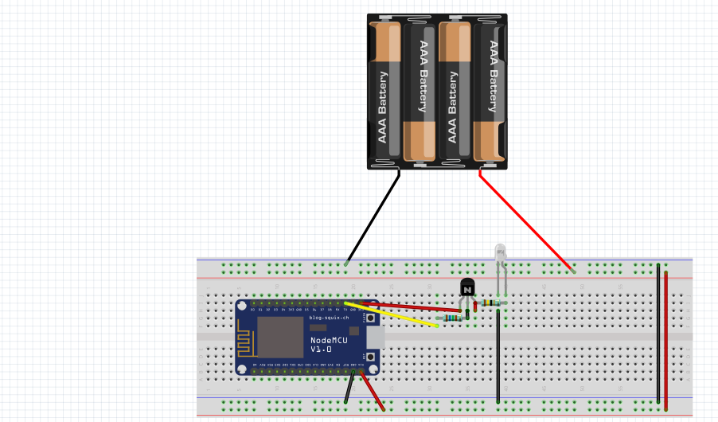
Implementation of Task 5.1 (cont.)
IR Transmitter Breadboard Design
Create breadboard design for IR transmitter

Slide 26
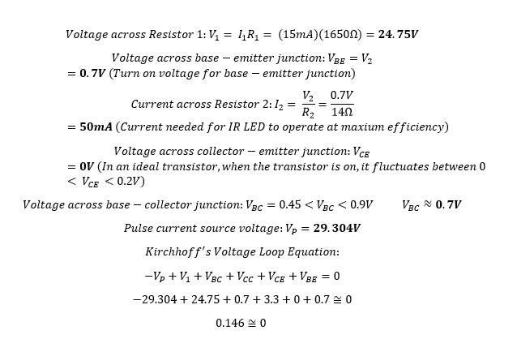
Implementation of Task 5.2
Calculations for IR Transmitter Circuit
Circuit Design Simulation (calculations)

Slide 27
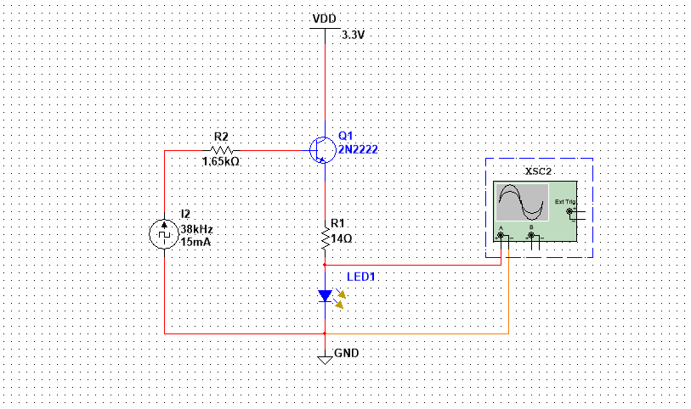
Implementation of Task 5.2 (cont.)
Simulation of IR transmitter circuit
Circuit design simulation

Slide 28
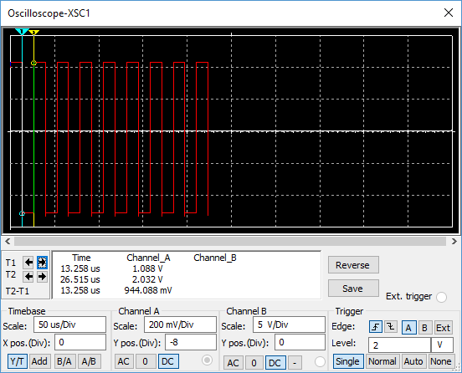
Implementation of Task 5.2 (cont.)
Simulation Results
Circuit design simulation (results)

Slide 29
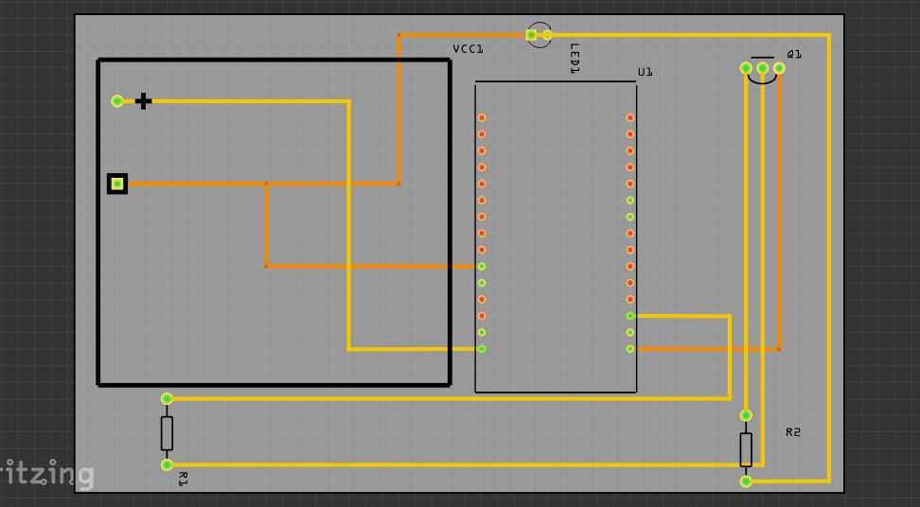
Implementation of Task 5.3
PCB Design of IR Transmitter
PCB Design of IR Transmitter circuit

Slide 30
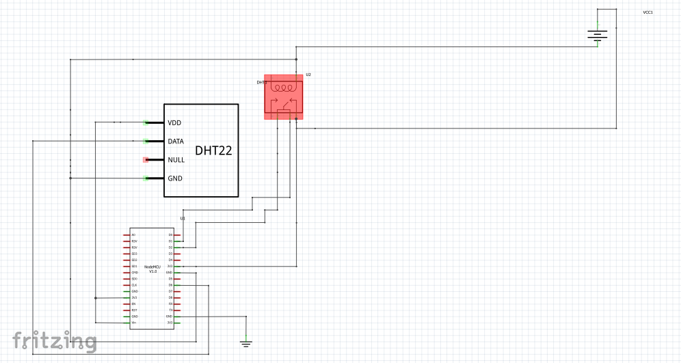
Implementation of Task 6.1
Temperature Control Schematic Design
Create schematic for temperature control

Slide 31
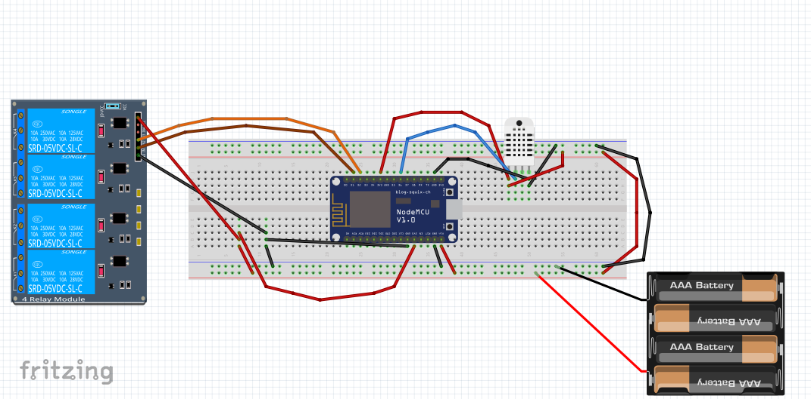
Implementation of Task 6.1 (cont.)
Temperature Control Breadboard Design
Create breadboard design for temperature control

Slide 32
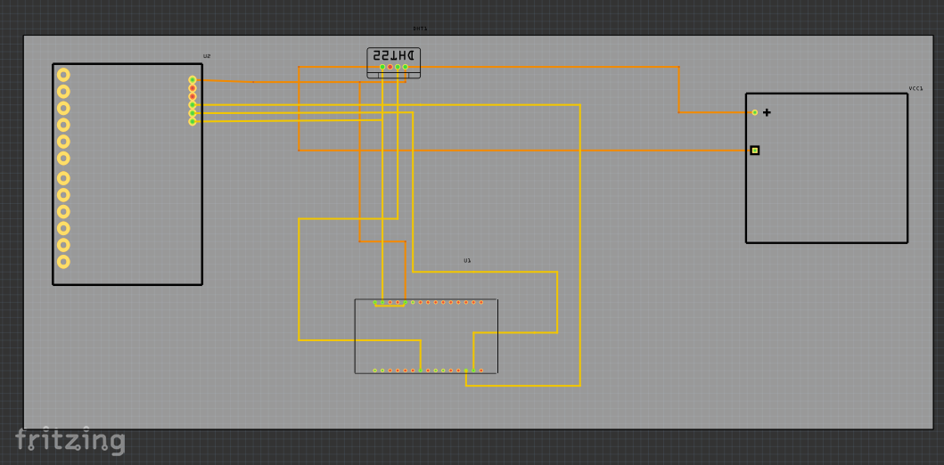
Implementation of Task 6.2
PCB Design for Temperature Control
PCB design of temperature control

Slide 33
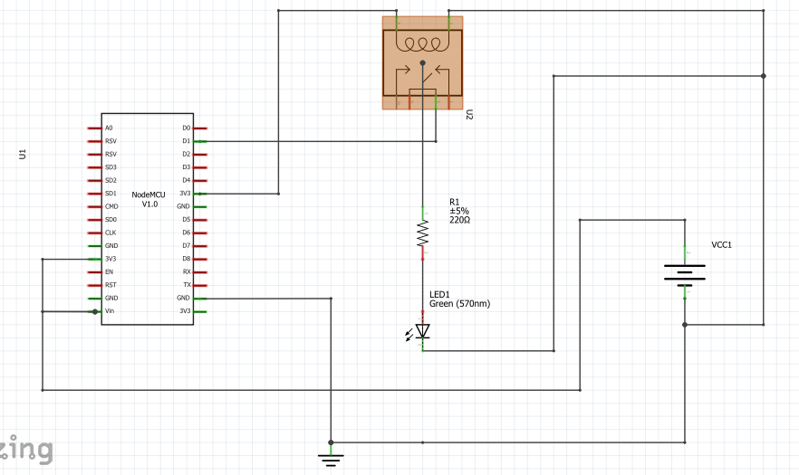
Implementation of Task 7.1
Light Control Schematic Design
Create schematic for Light Control

Slide 34
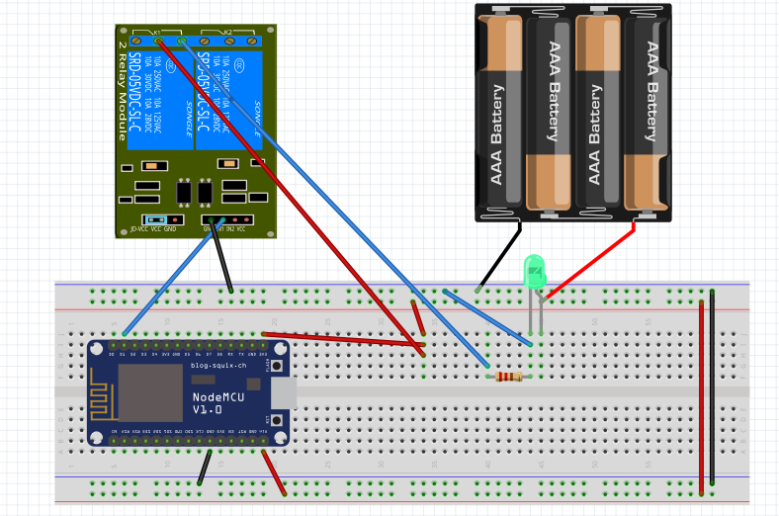
Implementation of Task 7.1 (cont.)
Light Control Breadboard Design
Create breadboard design for Light Control

Slide 35


ABET Outcomes
(a) An ability to apply knowledge of mathematics, science, and engineering
(b) An ability to design and conduct experiments, as well as to analyze and interpret data
(c) An ability to design a system, component, or process to meet desired needs within realistic constraints such as economic, environmental, social, political, ethical, health and safety, manufacturability, and sustainability
(d) An ability to function on multidisciplinary teams
(e) An ability to identify, formulate, and solve engineering problems
(f) An understanding of professional and ethical responsibility
(g) An ability to communicate effectively
(h) The broad education necessary to understand the impact of engineering solutions in a global, economic, environmental, and societal context
(i) A recognition of the need for, and an ability to engage in life-long learning
(j) A knowledge of contemporary issues
(k) An ability to use the techniques, skills, and modern engineering tools necessary for engineering practice.

Slide 36
Thank You!

